Slide 1
Virtual Machine

Slide 2
IaaS Cloud Services
IaaS is an instant computing infrastructure, provisioned and managed over the Internet.

Slide 3
Business Scenarios
Test and Development
Website Hosting
Storage, backup and recovery
Web Apps
High-performance computing
Big data analysis
Extended Datacenter

Slide 4
Planning Checklist
Start with the network
Name the VM
Decide the location for the VM
Determine the size of the VM
Understand the pricing model
Storage for the VM
Operating System

Slide 5
Name the VM
Element | Example
Environment | stg, prod, dev, QA
Location | Uw, ue
Instance | 01, 02, 03, 04, 05
Product or Service | service
Role | Sql, web, messaging
Devusc-webvm01

Slide 6
Location of the VM
The Location can limit your available options
There are price differences between locations

Slide 7
Pricing
Compute Cost: Compute expenses are priced on a per-hour basis but billed on a per-minute basis.
Consumption-based
Reserved Virtual Machine Instances
Storage Cost: Cost of the disk

Slide 8
Virtual Machine Sizing
General Purpose
Compute Optimized
Memory Optimized
Storage Optimized
GPU
High Performance Compute
https://learn.microsoft.com/en-us/azure/virtual-machines/sizes
Note: Be cautious when resizing production VMs

Slide 9
Virtual Machine Disk
OS Disk
Temporary Disk – Non-persistent Storage
Data Disk

Slide 10
Operating System
Windows
Linux

Slide 11
Connect to VM
Windows – RDP - 3389
Linux – SSH - 22

Slide 12
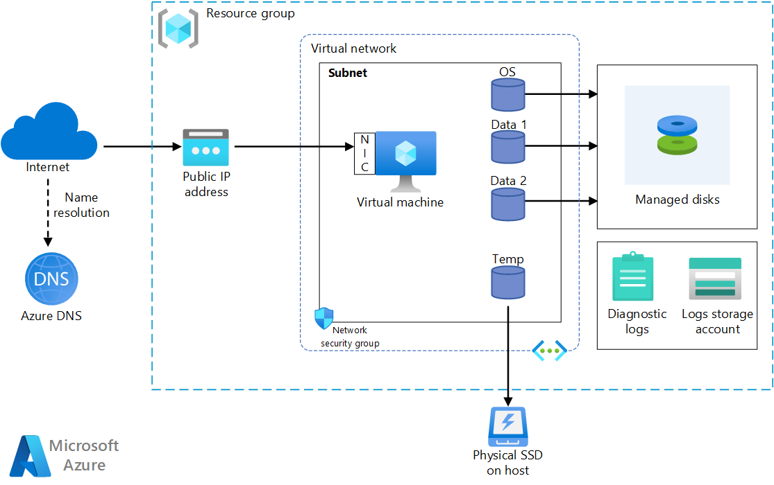
VM Architecture

Slide 13
Stopping the VM
Shutdown
Disconnect
Close the RDP
Stop from Portal
Deallocate

